Slide 1
Character Arrays
Programming – Introduction to C++
Last modified 27/01/2016 by Conan Bourke

Slide 2
Contents
ASCII
Arrays of characters
Null terminator
Character functions
strlen
strcmp
strcpy
strcat

Slide 3
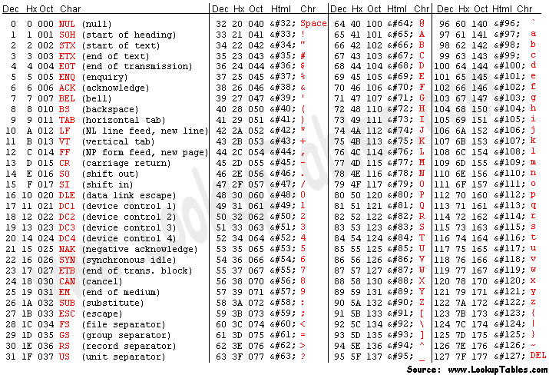
ASCI
ASCII is a cypher that lets us store characters inside a computer
All variable types in C store numbers
ASCII maps the numbers 0-127 to different characters

Slide 4
ASCII
Each number from 0-127 has a corresponding letter
0 – null character
1-31 – special characters
32 – 64 punctuation
48 – 57 – numbers
65 – 90 upper case letters
91 – 96 more punctuation
97-122 lower case letters
123 – 127 even more punctuation

Slide 5
Arrays of Characters
Arrays of characters work the same as regular arrays for the most part
//Uninitialized array of 16 characters
char name0[16];
//Initialized with a maximum space of 8
char name1[8] = "John";
//Initialized to be 7 characters – 6 for the name plus one for the null character
char name2[] = “Egbert";

Slide 6
Null Terminator
Character arrays are special
A character array uses something called a null terminator
With a regular array, you have a block of memory
To keep track of how long it is, you need to have a separate variable

Slide 7
Null Terminator
Unlike other arrays, in a character array the end of a string is indicated by the value 0
You can’t do this with most arrays as 0 could be a valid value in the middle of the array
In ASCII, however, 0 is a reserved value that specifically means the end of the string
char name[8] = "John"; //initialized with a maximum space of 8
Character | ‘J’ | ‘o’ | ‘h’ | ‘n’ | \0 | Garbage | Garbage | Garbage
Notes:
Make it clear that the null terminator is automatically

Slide 8
Null Terminator
Important things to know:
You still need to create an array that’s big enough
You only have the space you allocate
Be careful not to overwrite the null character
Many functions expect the null terminator to be there and will crash you program (in the best case) if its not there

Slide 9
Printing Character Arrays
In the previous lecture, we covered the fact the you can’t just use an array with std::cout – you have to iterate over all the elements
This isn’t true for character arrays
You can give std::cout a character array and it will print all characters until the null terminator
int numbers[] = {4, 1, 2, 9, 6};
char name[] = "Jarrad";
std::cout << numbers << std::endl; //DOES NOT WORK
std::cout << name << std::endl; //Does work

Slide 10
C Runtime Library Functions
Built into the C standard library, there are a number of functions that let you examine and modify character strings
strlen ( String Length )
strcmp ( String Compare )
strcpy ( String Copy )
strcat ( String Concatenate )

Slide 11
strlen – String Length
strlen is a function that takes in a string and returns the number of characters stored until the null termination character
//There is space for 16 chars reserved
char name[16] = "Matthew"; //the array looks like this M-a-t-t-h-e-w-0
strlen(name); //strlen returns 7 because that’s how many characters are before the 0

Slide 12
strlen – String Length
strlen works by just iterating through the characters in the string, counting how far its gone until the null termination character
FUNCTION strlen(string)
SET character_index to 0
WHILE string[character_index] != 0
character_index++
ENDWHILE
RETURN character_index
ENDFUNCTION

Slide 13
strcmp – String Compare
strcmp compares if two character arrays are equal to each other
In C, you CANNOT just use the equality operator (==) on arrays as it only returns true if the two arrays are the exact same array, not if their contents are the same
To check if two strings are the same, you need to use strcmp instead
strcmp returns 0 if the two strings are the same, 1 if the first string is lexicographically after the second, and -1 if the first is lexicographically before the second
Notes:
Lexicographically – the alphabetic order.

Slide 14
strcmp – String Compare
char name1[] = "John";
char name2[] = "John";
char name3[] = "Jess";
if (name1 == name2) {
//DOES NOT WORK }
if (strcmp(name1, name2) == 0)
{
//DOES WORK }
//Returns 1
strcmp(name1, name3);
//Returns -1 strcmp(name3, name1)

Slide 15
strcmp – String Compare
FUNCTION strcmp(string1, string2)
SET character_index to 0
SET result to 0
SET running to true
WHILE running
IF string1[character_index] == 0 AND string2[character_index] == 0 THEN
SET result to 0
BREAK
ELSEIF string1[character_index] > string2[character_index] THEN
SET result to 1
BREAK
ELSE IF string1[character_index] < string2[character_index] THEN
SET result to -1 BREAK
ELSE
++character_index
ENDIF
ENDWHILE
RETURN result
ENDFUNCTION

Slide 16
strcpy – String Copy
strcpy copies one string over another string
It overwrites any data that was previously in the destination string
You need to use this any time you want to initialize one string with another string

Slide 17
strcpy
char name1[] = "John";
char name2[64]; //Make sure you allocate enough space for what you want to copy in!!!
name2 = name1; //DOES NOT WORK
//name2 is now John
strcpy(name2, name1);
FUNCTION strcpy(destination, source)
SET character_index to 0
WHILE source[character_index] != 0
SET destination[character_index] to source[character_index]
++character_index
ENDWHILE
SET destination[character_index] to 0
RETURN destination
ENDFUNCTION

Slide 18
strcat – String Concatenate
strcat copies a string to the end of another other string
Unlike strcpy, it preserves the contents of the destination string

Slide 19
strcat – String Concatenate
//Make sure you allocate enough space for the new string to be added to the end!!!
char name1[64] = "Dennis";
char name2[] = "Richie";
name1 += name1; //DOES NOT WORK
//name1 is now Dennis Richie
strcat(name1, name2);
FUNCTION strcpy(destination, source)
SET destination_index to strlen(destination) + 1
SET source_index to 0
WHILE source[source_index] != 0
SET destination[destination_index] to source[source_index]
++destination_index
++source_index
ENDWHILE
SET destination[destination_index] to 0
RETURN destination
ENDFUNCTION

Slide 20
Summary
Character arrays are a bit different from other arrays because of the null terminator
There are a number of simple C functions that help you do common operations on character arrays
There is a C++ class we will cover later called std::string that can simplify a lot of these operations

Slide 21
References
Prata, S, C++ Primer Plus, 6th Ed, Addison-Wesley Professional (2011)

